Slide 1
Network Security and Ethical Hacking
Chapter 4

Slide 2
How Does Network Security Work?
Network security works through
multiple protective layers that control access at both the network edge and inside the environment.
Each layer ensures only authorized users can access resources while blocking threats.
Core idea is to protect large amounts of data using layered defenses that enforce rules before any action is allowed.

Slide 3
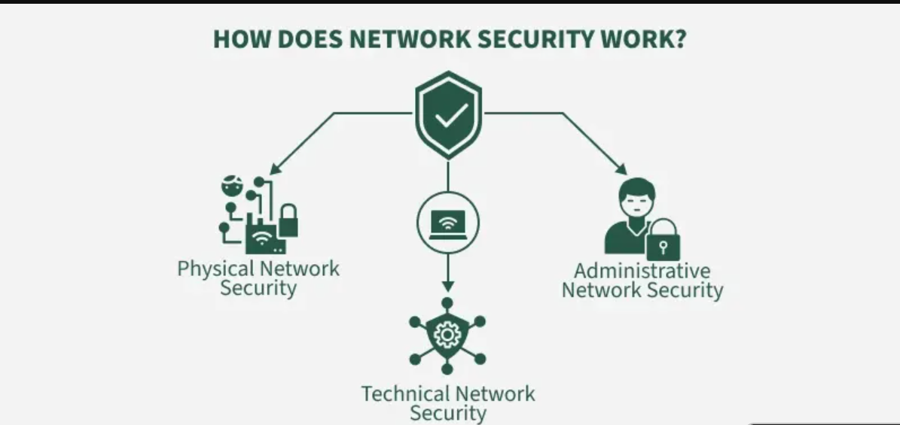

Slide 4
Physical Network Security
Physical security prevents unauthorized individuals from physically accessing network hardware, servers, or devices.
Uses access cards, biometrics, CCTV, and locked server rooms
Protects routers, switches, cables, and data centers
Prevents tampering, device theft, and hardware-level attacks

Slide 5
Technical Network Security
Technical security protects data as it is stored, processed, and transmitted across the network using software-based controls.
Secures data in motion and at rest
Blocks unauthorized access and malicious activities
Includes firewalls, encryption, antivirus, and intrusion detection

Slide 6
Administrative Network Security
Administrative security
Defines policies, user permissions, and procedures that control how the network is accessed and managed.
Manages authentication, authorization, and user roles
Enforces security policies and access controls
Ensures proper configuration, monitoring, and compliance

Slide 7
Types of Network Security
Email Security
Email security protects email accounts from phishing, malware, fraud, data theft, and unauthorized access.
Filters spam, malicious links, and phishing emails
Blocks risky attachments and outbound data leaks
Protects one of the most commonly exploited attack vectors.

Slide 8
Network Segmentation
Network segmentation divides a network into isolated segments to reduce attack spread and enforce security policies.
Separates sensitive systems from general access
Limits lateral movement during attacks
Access granted based on identity, role, and device

Slide 9
Access Control (NAC)
Access control ensures only authorized users and compliant devices can connect to the network.
Identifies devices before granting access
Restricts or blocks non-compliant endpoints
Enforces authentication and authorization policies

Slide 10
Web Security
Protects users, browsers, and websites from malicious sites, downloads, and online threats.
Blocks harmful URLs and web-based attacks
Secures web gateways on and in the cloud
Protects organizational websites from vulnerabilities

Slide 11
Firewall Security
Firewalls filter network traffic based on rules to block unauthorized access while allowing legitimate communication.
Acts as a barrier between trusted and untrusted networks
Controls inbound and outbound traffic
Prevents intrusions and unauthorized connections

Slide 12
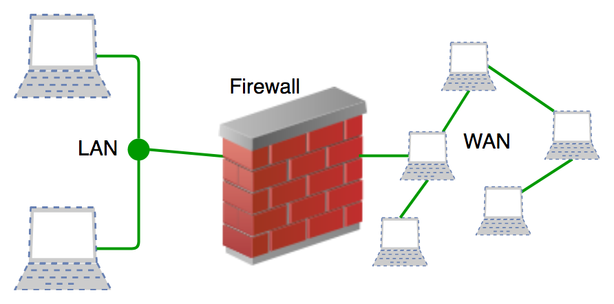

Slide 13
Wireless Security
Wireless security safeguards Wi-Fi networks from unauthorized access and wireless-specific attacks.
Prevents rogue access points and Wi-Fi cracking
Uses protocols like WPA3 (Wi-Fi Protected Access 3)
Protects communication beyond physical boundaries

Slide 14
Mobile Device Security
Mobile security protects smartphones, tablets, and BYOD devices from threats and unauthorized access.
Bring Your Own Device (BYOD) is an IT policy allowing employees to use personal devices—smartphones, laptops, and tablets—for work purposes.
Controls which devices can connect to the network
Enforces encryption and secure connection policies
Monitors mobile traffic for suspicious activity

Slide 15
What is Hacktivism ?
Now people use social media to protest and raise their voices about political or social issues instead of marching on the street.
Hacktivism combines ‘hacking’ with ‘activism’, where a person or organization uses hacking to fulfill a political or social agenda.
Hacktivism is often associated with the term Cyberwar, and is sometimes associated with "Cyber Terror".
So Hacktivism basically means an act of hacking or breaking into a computer system for some purpose be it political or social.
The person who performs this is called a hacktivist.

Slide 16
Hacktivism is different from regular cybercrime because in this cybercriminals doing hacking for the personal gain, like making money.
On the other side Hacktivists have a purpose behind their actions or doing hacking, such as raising awareness or fighting for the cause.
This can vary from violence, censorship, human rights, voyeurism, and countless other motives.
Some people think hacktivism is just a digital way of protesting, while others believe it's completely wrong and against the law.

Slide 17
Ethical hacking
Ethical hacking is the authorized practice of testing systems, networks, and applications to identify and fix security weaknesses before malicious attackers exploit them.
Ethical hackers use real hacking techniques with permission to strengthen cybersecurity and protect digital assets.

Slide 18
Legal and professional security testing
Ethical hackers simulate real-world cyberattacks
Helps identify vulnerabilities and weak points
Strengthens an organization’s overall security posture
Supports compliance with cybersecurity standards
Builds resilience against modern cyber threats

Slide 19
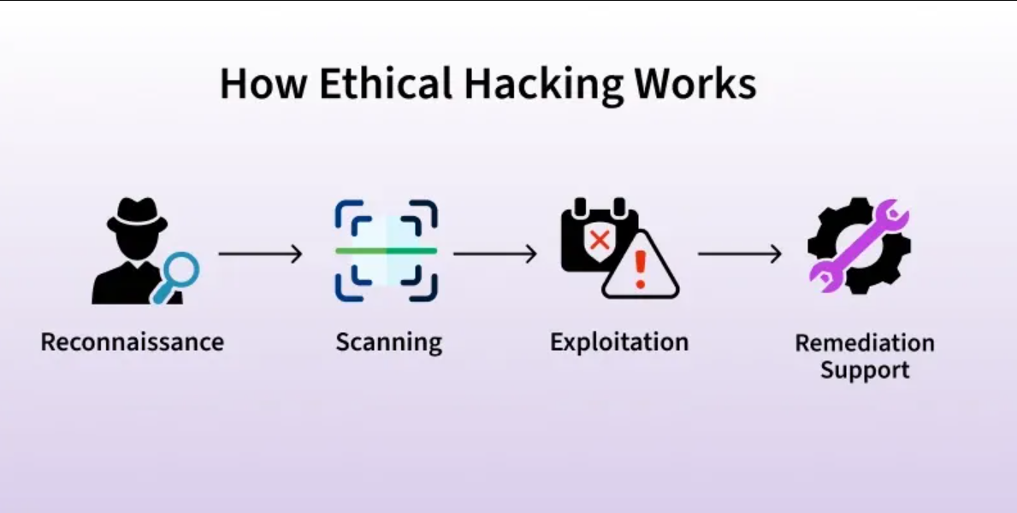

Slide 20
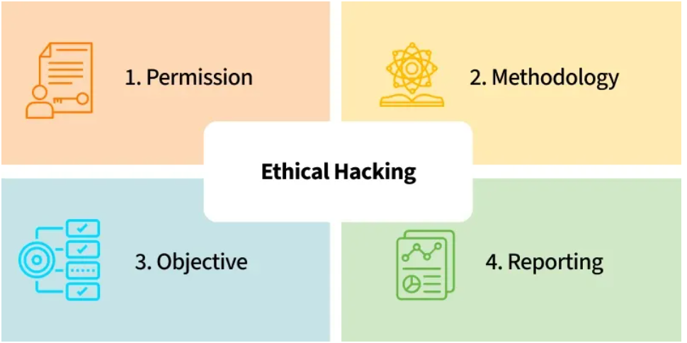
Key aspects of Ethical Hacking

Slide 21
Reporting: Ethical hackers report back to the organization with the results of the tests.
Permission-Based: This permission becomes necessary to differentiate their job from criminal hacking jobs
Objective: The main goal is to find the holes before hostile attackers can penetrate them. This includes discovering system, application, and network vulnerabilities that an attacker could exploit.
Methodology: Ethical hackers perform these steps using a variety of tools and techniques, similar to criminal hackers.

Slide 22
Importance of Ethical Hacking
Ethical hacking contributes significantly to contemporary cybersecurity, ethical hackers are able to identify and address vulnerabilities before they are exploited by simulating the strategies and tactics utilized by cybercriminals. This proactive methodology serves to:
Enhance Security: Identify and address flaws to stop data breaches and cyberattacks.
Compliance: Meet security standards set by the industry and regulatory requirements.
Management of risk: Assess and reduce potential threats to the assets of the organization
Occurrence Reaction: Enhance the company's capacity to respond to security incidents and recover from them.

Slide 23
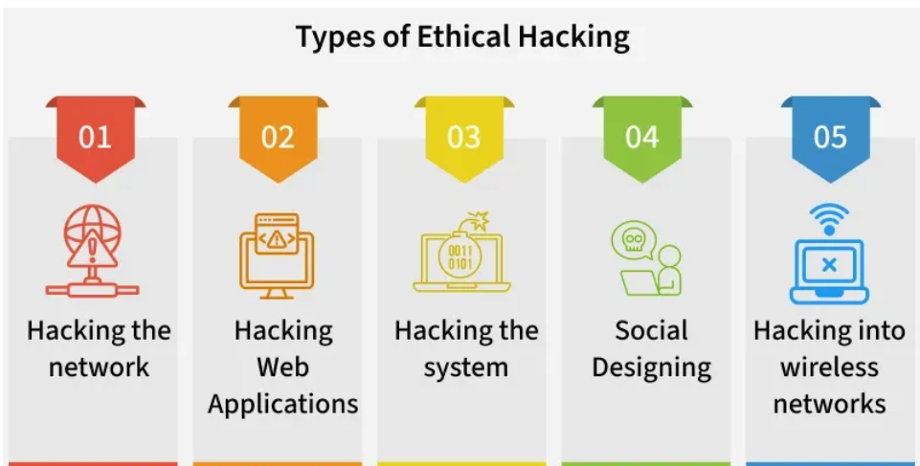
Types of Ethical Hacking

Slide 24
Hacking the network: involves testing the infrastructure of the network in order to find flaws in the protocols, configurations, and devices of the network
Hacking Web Applications: Centers around distinguishing shortcomings in web applications, for example, SQL injection or cross-website prearranging (XSS) weaknesses
Hacking the system: Targets working frameworks and programming to find security defects that could be taken advantage of.
Social Designing: attempts to manipulate individuals into revealing confidential information or performing actions that could compromise security, putting the human element to the test.
Hacking into wireless networks: involves identifying potential dangers in wireless communications and evaluating the security of wireless networks.

Slide 25
Types of Ethical Hackers
Ethical hacking is to scan vulnerabilities and to find potential threats on a computer or network.
An ethical hacker finds the weak points or loopholes in a computer, web application or network and reports them to the organization.

Slide 26
White Hat Hackers
The white hat hackers are the ethical security professionals authorized to test systems for vulnerabilities.
They work under legal agreements with the organization.
White hat hackers receive target information from the organization,
Perform penetration testing, vulnerability scanning, and security assessments, and then report their findings to help strengthen defenses before malicious attacks occur.

Slide 27
A white hat hacker typically holds a
bachelor’s degree in Computer Science, Information Technology, or Cybersecurity,
possesses knowledge of networking, operating systems, programming, and security tools,
and often earns certifications such as CEH, CISSP, or OSCP.

Slide 28
Black Hat Hackers
They act without the organization’s permission, making their activities illegal.
Black hat hackers illegally break into websites, systems, or admin panels by exploiting security vulnerabilities.
They aim to gain personal financial benefits or power, with no regard for the harm caused.
They can alter system functions, delete data, or disrupt services, causing significant financial and operational losses.
Such actions are criminal offenses, punishable by fines, imprisonment, and permanent reputational damage.

Slide 29
Example: A hacker secretly breaks into an e-commerce site’s database.
Steals customer credit card numbers and personal details.
Sells this data on the dark web for profit.
Causes financial loss and damages the company’s reputation.

Slide 30
Grey Hat Hackers
Sometimes access data and violate laws without permission.
Do not have the same malicious intent as Black Hat hackers; often act for the common good.
Grey hat hackers are trying to help by finding security flaws, their unauthorized actions can still cause problems — such as disrupting services, exposing sensitive data, or creating vulnerabilities that others might exploit.
Unauthorized access can disrupt operations and cause financial losses.
Risk of accidentally causing damage while identifying vulnerabilities.

Slide 31
Example: Imagine a college student finds a flaw in the university’s online portal.
Instead of reporting it privately to the IT department, they post the flaw on social media to prove their skills.
They did not steal grades or data, but their public disclosure could let malicious hackers exploit it

Slide 32
Blue Hat hackers
They are called beginner hackers with limited skills, often using pre-made tools.
They motivated mainly by revenge against someone who angered or challenged them.
Blue hat hakcers mainly focus on personal payback rather than learning or professional growth.

Slide 33
Example: A gamer loses an online match and feels embarrassed because the opponent teased them in the game chat.
Out of anger, they download a simple DDoS (Distributed Denial of Service) tool from the internet and use it to temporarily crash the opponent’s game server or internet connection.

Slide 34
Green Hat hackers
They care about hacking and Beginner hackers who are still learning but are passionate about improving their skills.
Eager to learn from experienced hackers, often asking questions and studying techniques.
Motivated by curiosity and growth, aiming to become skilled, professional hackers in the future.
Example: A beginner joins an online hacking community, asks questions about penetration testing, and practices legally on test websites to improve their skills

Slide 35
Red Hat Hackers
They Known as “eagle-eyed hackers,” they aim to stop black hat hackers, similar to white hats.
Use aggressive tactics against malicious hackers, often going beyond standard ethical hacking methods.
Attack black hat systems so severely that the hacker may need to replace their entire setup.

Slide 36
Example: A black hat hacker tries to hack into a company’s database to steal customer details. A red hat hacker detects the attack, hacks back into the black hat’s computer, and floods it with malware that destroys their files and operating system.
This forces the attacker to buy a new computer before they can attempt hacking again.

Slide 37
How Cyber Crimes start ?
1. Most Common factor : addiction in Online Gaming
Game age should be appropriate.
Parental control should be their if is some accessory to be purchased in games.
Cases have been reported when child was playing game from father mobile.
He was so addicted that to take game to next level, he did some financial transaction form his father mobile app to buy game pass, diamonds etc.

Slide 38
2. Influence of Online Content and Communities 🌐
Videos, forums, and social media sometimes glorify hacking or digital fraud. Some youths follow tutorials or join groups where cybercrime techniques are discussed, which normalizes such behavior.
3. Desire for Quick Money 💰
Cybercrime such as online scams, phishing, fake job offers, or mule accounts may appear to be an easy way to earn money without much effort.
4. Peer Pressure 👥
Friends or online contacts may encourage someone to try hacking or fraud. When a group is involved, the individual may feel it is “normal” or harmless.
5. Lack of Awareness of Legal Consequences ⚖️
Many youngsters believe cyber activities are anonymous and that they will not get caught. They may not know about strict laws like the Information Technology Act, 2000, which includes serious penalties for cyber offenses.

Slide 39
Digital Citizenship
Another problem seen is of social media where child makes friendship with unknown people, getting attracted towards them.
They start liking unknown people.
One cannot determine who is sitting behind that ID.
Person does good chatting and sometimes emotionally child give their personal information, videos, pictures to them.
Then they are being blackmailed.
Therefore guiding children about Digital Citizenship is very essential now.

Slide 40
Balanced Digital Diet
We take balanced diet for our body, so we need a digital diet for our well being too.
During consumption of Digital diet, if a wrong content is consumed.
Then child need some detox, some guidance.
Technology is making our child sharper while through negative content their mindset can be lured fro cyber crimes too.
Therefore all stakeholder need to give balanced digital diet to our children and tell them the best use of technology.

Slide 41
Definitions of DC and DD
Digital citizenship refers to the
responsible and respectful use of technology and online behavior
encompassing skills like online safety, privacy, and ethical communication within digital communities.
Digital diet refers to
strategies for mindful and balanced digital consumption,
aiming to improve mental well-being, focus, and overall quality of life by reducing excessive screen time and negative online habits.

Slide 42
Have you ever heard about DQ ?
All of you have good IQ
But here I want to talk about Digital Quotient.
DQ refers to an individual's or organization's ability to understand, adopt, and leverage digital technologies effectively.
I asked my one student in class that from where you can make passport.
He said there are many passport sewa kender on Google.
But Govt. of India has put a advisory on their website about fake passport domains, still many fall to its prey.

Slide 43
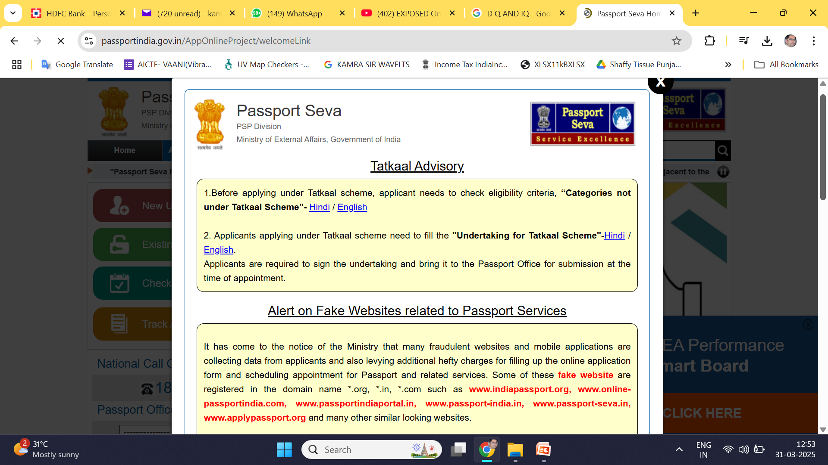

Slide 44
I want DQ to be smart in addition to IQ.
My bank domain name is hdfcbank.com, I should not open hdfc.org or hdfcbank.in
Hacking any influencer account with fake vote program is popular nowadays
Once you click on vote button, account is hacked and same hacker will post now stories on that account with some lucrative post
So Crypto scammers and other are hacking big influencers onwards
So every time you have double lock on your passwords.

Slide 45
Fraud via APK (Android Package Kit): A Growing Cyber Threat
Any Possible Solution

Slide 46
What is an APK File?
An APK contains:
Code (java)
Resources (images, layouts)
Manifest file (permissions, app components)
Certificates (for signing the app)
Attackers manipulate these components to insert malicious code.

Slide 47
How malicious APKs are typically created
Attackers take a real app, modify it, and redistribute it:
Extract APK using tools (reverse engineering)
Insert malicious code (e.g., data stealing logic)
Rebuild and sign the APK
Share via unofficial app stores or links
This is why downloading outside Google Play Store can be risky.

Slide 48
APK are raw file which have all sorts of permission added through coding and can be given name lik wedding.apk
You might be confused with E Greetings, it will ask something in English which we mostly ignore and does OK OK, ALLOW ALLOW.
It’s a malware.

Slide 49
Unknown to the users, these permissions enabled the app to perform actions that compromised their personal and financial security.
App appeared legitimate and offered a smooth user experience, which led many to trust it without questioning the extensive permissions it requested during installation.

Slide 50
How these permission are created ?
Once installed, the app requested permissions that allowed it to access sensitive areas of the user’s phone.
JavaScript is one programming languages for hacking web applications.
Understanding JavaScript allows hackers to discover vulnerabilities and carry out web exploitation since most web applications use JavaScript or its libraries.

Slide 51
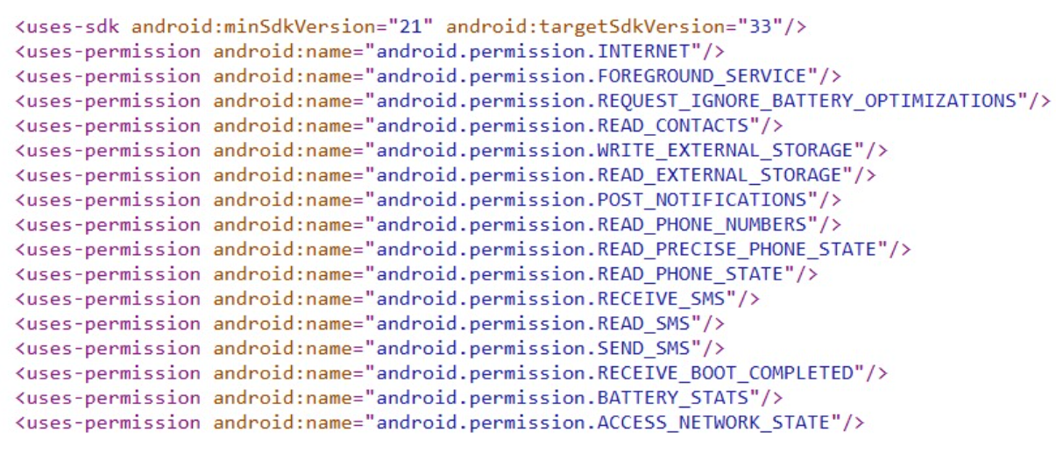
Permissions exploited by the APP

Slide 52
Cybercriminals often disguise these APK files as popular apps, tricking users into believing they are downloading legitimate software.
Malicious software can operate in the background without the user’s knowledge, silently harvesting data or even taking control of certain device functions.
Attackers create look-alike apps of popular services like:
Banking apps
Gaming apps
Social media apps

Slide 53
Steps typically used by attackers:
Download legitimate APK.
Decompile it.
Insert malicious code.
Rebuild APK.
Sign with new certificate.
Distribute through fake websites or messaging apps.

Slide 54
Distribution Methods Used by Cybercriminals
Malicious APKs are spread through:
WhatsApp / Telegram links
Fake updates
Third-party app stores
Phishing websites
Social engineering messages
Many Indian cyber fraud cases involve fake APKs pretending to be:
KYC update apps
Electricity bill apps
Government service apps

Slide 55
Common types of malicious code inserted in legitimate APKs
Trojan Code
Hidden malicious functionality inside a normal-looking app.
Example: A flashlight app secretly sends SMS or steals contacts.
Keylogger
Records every keystroke typed by the user.
Spyware Code
Code that secretly monitors user activity like Pegasus spyware and FlexiSpy

Slide 56
Indicators of a Malicious APK
Any Guess

Slide 57
Indicators of a Malicious APK
Requests too many permissions
Installed from unknown sources
App size unusually small or large
Hidden icon after installation
Antivirus warnings

Slide 58
Phases of System Hacking
System hacking usually occurs in an organized fashion, normally following the lifecycle of an ethical hacker. The most important phases are:

Slide 59
1. Reconnaissance
Gathering information on the target system (e.g., IP addresses, operating systems, open ports).
Tools: Nmap, Whois, Google Dorks.
2. Scanning
Vulnerability identification in the target system (e.g., open ports, services, misconfigurations).
Tools: Nessus, OpenVAS, Nikto.
3. Gaining Access
Illicit access to the system using vulnerabilities.
Techniques: Password cracking, exploiting software vulnerabilities, social engineering.

Slide 60
4. Maintaining Access
Guaranteed ongoing access to the system (e.g., installing backdoors, rootkits).
Tools: Metasploit, Netcat.
5. Clearing Tracks
Erasure of attack traces to avoid detection.
Techniques: Log deletion, timestamp manipulation.

Slide 61
Information Gathering (Reconnaissance)
Information Gathering is the process of collecting publicly available information about a target (organization, website, network, or system) before any attack or security assessment.
It is widely used in:
Ethical hacking
Cybersecurity auditing
OSINT (Open Source Intelligence)
Digital forensics
Academic & technical research

Slide 62
Types of Information Gathering
Passive Information Gathering
No direct interaction with the target
Low risk of detection
Example: Google search, archive.org, WHOIS
Active Information Gathering
Direct interaction with servers
May be logged by the target
Example: DNS queries, dig, dnsenum

Slide 63
Advanced Google Search (Google Dorking)
Google Dorking, also known as Google Hacking, is a technique that uses advanced Google search operators to uncover sensitive files, login pages, databases, and other hidden information that is publicly accessible but not intended to be easily discovered.
Ethical hackers, cybersecurity professionals, and researchers apply these methods to test website security and gather insights, while attackers may misuse them to expose passwords, personal data, or confidential files. For example
Find login portals exposed online
Locate unsecured databases
Access confidential documents or files
Browse open file directories
Identify security vulnerabilities accidentally indexed by Google

Slide 64
How Does Google Dorking Work?
Google Dorking is the practice of using advanced search operators to filter search results that reveal hidden, confidential, or mistakenly indexed data.
This method relies on Google's indexing and crawling system, which scans through websites and stores sensitive documents in a cache.

Slide 65
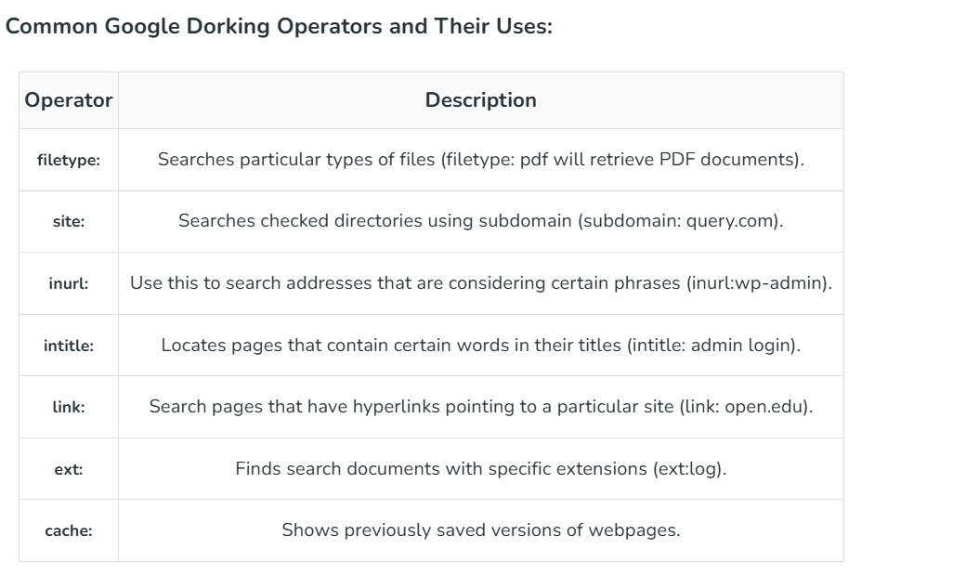

Slide 66
Search filters for Google Dorking
Google Dorking involves using advanced search operations in Google to search for specific keywords, file types, or website parameters.
These operators can be combined to create more powerful search queries that can reveal information that would not be easily accessible otherwise.

Slide 67
Information Collected
Subdomains
Login pages
Configuration files
PDFs, PPTs, DOCs
Exposed directories
Common Operators
site: – search within a domain
filetype: – search specific file formats
intitle: – search in page titles
inurl: – search in URLs

Slide 68
Archive.org (Wayback Machine)
Archive.org stores historical snapshots of websites taken over time.
Why is it important?
Even if a page is deleted, old data may still exist in archives.
Information Collected
Old web pages
Removed directories
Old admin panels
Previous technologies used
Exposed credentials (historically)
Example Use
Checking how a website looked 5 years ago
Finding removed URLs
Advantages
✔ Passive technique ✔ Helps understand website evolution
Limitation
❌ Not all pages are archived

Slide 69
Netcraft
Netcraft is an online service used to gather website infrastructure and hosting details.
Information Collected
Web server type (Apache, Nginx)
Operating system
Hosting provider
IP address
SSL certificate details
Website uptime
Use Case
Technology fingerprinting
Understanding server environment
Advantages
✔ Accurate infrastructure data ✔ Useful for security audits
Limitation
❌ Limited details in free version

Slide 70
WHOIS
WHOIS is a protocol used to obtain domain registration information.
Information Collected
Domain owner name (if not hidden)
Organization
Email address
Registrar
Registration & expiry dates
Name servers

Slide 71
HOST Command
host is a DNS lookup utility used to map domain names to IP addresses.
Information Collected
IP address of a domain
Mail servers
Name servers
Example

Slide 72
DIG (Domain Information Groper)
What is DIG?
dig is an advanced DNS query tool used to retrieve detailed DNS records.
Information Collected
A records (IP address)
MX records (mail servers)
NS records (name servers)
TXT records
TTL values
Example
dig example.com
Use Case
DNS troubleshooting
Understanding DNS architecture
Security analysis
Advantages
✔ Detailed and precise ✔ Industry-standard tool
Limitation
❌ Requires DNS knowledge

Slide 73
NMAP
Nmap (Network Mapper) is an open-source network scanning tool used to discover devices, identify open ports, detect services and their versions, and gather information about operating systems on a network. It is widely used for network auditing, security assessments, and troubleshooting. Nmap allows users to do a bunch of things that are related to a wide range of network-related tasks.
Network Discovery: With Nmap, users can scan networks and discover devices and hosts on a network, allowing network admins to understand the network more efficiently.
Port Scanning: It can determine which ports are open and which services are running on those ports, which is critical for security assessments and vulnerability scanning.
OS Fingerprinting: Nmap can attempt to identify the operating system running on a target host by analyzing various characteristics of network packets.
Network Monitoring: Nmap can be used for continuous monitoring to detect changes in the network environment.

Slide 74
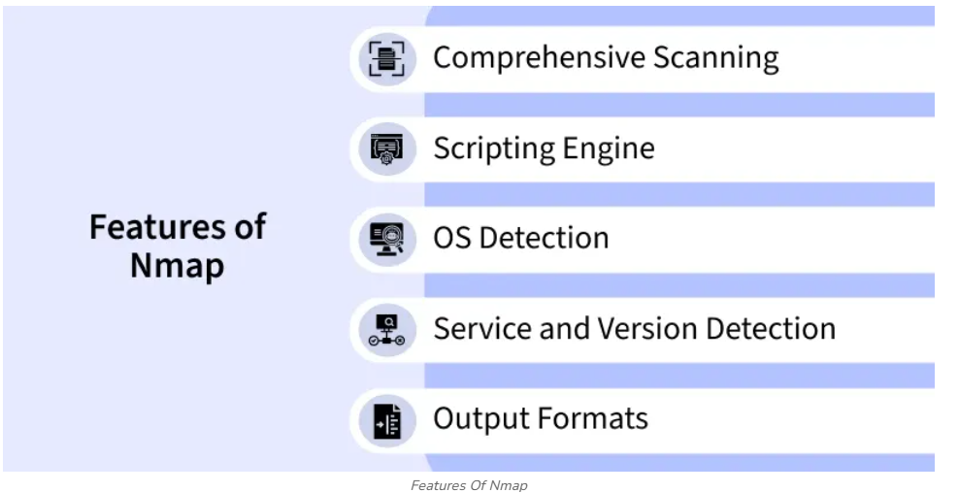

Slide 75
Comprehensive Scanning: Nmap can scan a variety of protocols and perform different types of scans.
Scripting Engine: Nmap Scripting Engine(NSE) allows users to write and run their custom scripts to automate various tasks of Nmap such as Network auditing and vulnerability scanning.
OS Detection: Nmap can used to identify the operating system of the target hosts based on their responses to the network probes.
Service and Version Detection: Nmap can accurately identify the services and versions that are running on the open ports of the target hosts.
Output Formats: Nmap supports multiple output formats for the scan results like plain text, XML, and greppable output.

Slide 76
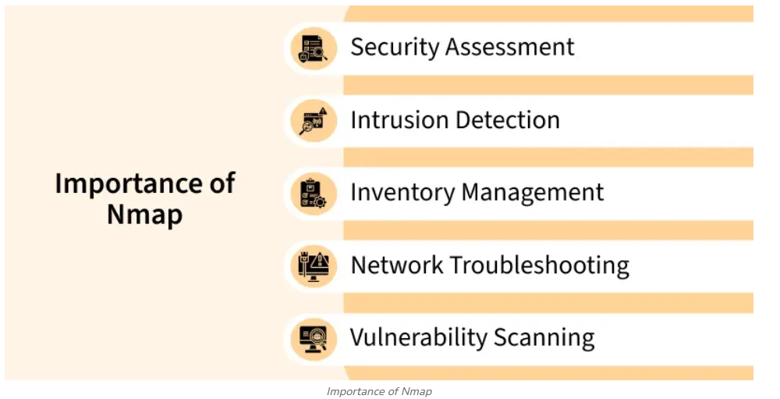

Slide 77
Security Assessment: One of the main reasons to have Nmap is to assess the security of your network. you can do this by scanning open ports and services, and can further identify potential entry points for attackers.
Intrusion Detection: Nmap can be used to detect unauthorized or unexpected changes in your network environment. Regular scans can help you identify new or rogue devices that shouldn't be on your network.
Inventory Management: Nmap provides an efficient way to create an inventory of all devices on your network. This is crucial for keeping track of your network's assets and ensuring you have control over what's connected.

Slide 78
Network Troubleshooting: Whenever there is a network issue, Nmap can help you identify the root cause of the issue by pinpointing the status of the network services and devices. which can further help you resolve the issue in a better manner.
Vulnerability Scanning: Nmap can be used in conjunction with vulnerability databases and scripts (such as NSE scripts) to scan for known vulnerabilities on devices. This aids in proactive security measures to patch or mitigate vulnerabilities before they are exploited.

Slide 79
What is Social Engineering?
Social Engineering is an umbrella term for multiple malicious activities done by cyber criminals over the internet through human interaction.
It doesn't involve the use of technical hacking techniques. Attackers use psychology and manipulation to trick users into performing actions that could compromise with their security including downloading malicious files, revealing sensitive information, clicking on malicious links, make transactions to illegal sources etc.
It includes range of attacks including Phishing, Baiting, Tailagting, Pretexting, Scareware etc. as they all exploit the human trust. Social engineering is often the first step of larger cyber attacks.

Slide 80
Purpose of Social Engineering Attacks
The purpose of social engineering attacks is typically to steal sensitive information, such as login credentials, credit card numbers, or personal information. Attackers can use this information for identity theft, financial fraud, or other malicious purposes. Another purpose of social engineering attacks is to gain unauthorized access to secure areas or systems.

Slide 81
How do Social Engineering Attack Works?
While social engineering attacks don't follow a fixed strategy, as attackers often adapt their tactics based on the victim, situation, and context, there are certain common elements that most social engineers employ. These key factors include:

Slide 82
1. Planning and Research
Before launching a social engineering attack, the attacker spends time gathering information. This phase is critical to the success of the attack. The attacker may collect publicly available information about the target through:
Social Media: Platforms like LinkedIn, Facebook, or Twitter can reveal personal details, job roles, contacts, and interests.
Company Websites: Details about employees, company structure, and operational processes can be found here.
Public Records: Information like employee directories, email addresses, and phone numbers can be found on company websites or government databases.
This information helps the attacker craft a believable and tailored message, increasing the likelihood of success.

Slide 83
2. Creating a Convincing Pretext
The attacker develops a pretext, story designed to gain the trust of the victim. For example:
Impersonation: The attacker might pose as a company executive, technical support, or a trusted colleague to ask for sensitive information or access.
Urgency or Pressure: The attacker may create a sense of urgency to pressure the victim into acting quickly, such as claiming that immediate action is needed to fix a system issue or resolve an account problem.
Familiarity: Attackers often use personal information about the target to make their approach seem more genuine (e.g., referencing the target’s recent social media posts or common connections).
The goal is to exploit the victim's natural tendency to trust familiar sources, especially in a work or personal context.

Slide 84
3. Engaging with the Victim
After the pretext is established, the attacker engages with the victim. The attack may take different forms:
Phishing Emails: The attacker sends an email that appears legitimate, asking the victim to click on a malicious link or open an infected attachment. The email often includes a request for login credentials, sensitive data, or other confidential information.
Phone Calls (Vishing): The attacker calls the victim, pretending to be from IT support or a trusted institution, and asks the victim to provide personal or financial information.
SMS Messages (Smishing): The attacker sends a text message that mimics a legitimate service, prompting the victim to click on a malicious link or provide confidential information.

Slide 85
4. Exploiting the Trust
Once the victim responds, the attacker exploits the trust established through the pretext. This could involve:
Stealing Information: The attacker may gather sensitive data like login credentials, financial information, or personal identifiers.
Gaining Unauthorized Access: The attacker may trick the victim into granting access to critical systems, networks, or databases, either by clicking on a link, downloading malware, or entering login credentials.
Installing Malware: In some cases, the attacker may convince the victim to download malware disguised as legitimate software or documents, which could then be used to access the victim’s system or data remotely.

Slide 86
5. Taking Advantage of the Information
After successfully obtaining the desired information or access, the attacker can:
Perform Financial Fraud: Using stolen credentials or sensitive data, the attacker can make unauthorized financial transactions.
Access Sensitive Systems: The attacker may now have the ability to breach more secure areas of the organization, often leveraging compromised accounts to move laterally through the network.
Install Ransomware: If the attacker has gained access to critical systems, they may deploy ransomware to demand payment for decryption.
Sell Stolen Data: The attacker may sell sensitive information, such as personal records, intellectual property, or financial data, on the dark web.

Slide 87
6. Covering Their Tracks
Social engineers are often skilled at erasing signs of their presence. After exploiting the victim, they may:
Delete or Modify Logs: Attackers may delete communication logs or traces of malware to avoid detection.
Use Encryption: The attacker may encrypt sensitive data to prevent the victim from accessing it or identifying the breach.
This stage ensures the attacker remains undetected for a longer period, allowing them to continue exploiting the situation or sell the data they have stolen.

Slide 88
Types of SE Attacks
1. Phishing
Phishing is a type of social engineering attack that involves sending an email or message that appears to be from a legitimate source, such as a bank, in an attempt to trick the recipient into revealing their login credentials or other sensitive information.
2. Baiting
Baiting is a type of social engineering attack that involves leaving a tempting item, such as a USB drive, in a public place in the hope that someone will pick it up and plug it into their computer. The USB drive is then used to infect the computer with malware.
3. Tailgating
Tailgating is a type of social engineering attack that involves following an authorized individual into a secure area, such as a building or data center, without proper authorization.

Slide 89
4. Pretexting
Pretexting is a type of social engineering attack that involves creating a false identity or situation in order to trick an individual into revealing sensitive information. For example, an attacker might pretend to be a customer service representative in order to trick an individual into giving them their login credentials.
5. Scareware
Scareware is when the victim is sent false messages claiming their system is infected with a malware, or outdated, suggesting them to download softwares t

Slide 90
Prevention
1. Avoid Opening Emails and Attachments from Suspicious Sources
Phishing emails often appear legitimate but contain malicious links or attachments designed to steal personal information or install malware. Always be cautious when receiving unsolicited emails, especially those requesting sensitive data or action.
Check the sender's email address carefully.
Avoid clicking on suspicious links or downloading attachments.
Verify requests through alternative channels (e.g., by calling or messaging the official number).
2. Enable Multi-Factor Authentication (MFA)
Multi-factor authentication (MFA) adds an extra layer of security by requiring more than just a password. This reduces the risk of unauthorized access, even if your password is compromised.
Enable MFA for critical accounts (e.g., email, banking, social media).
Use authentication apps like Google Authenticator for added security.
Enable biometric authentication where possible.

Slide 91
3. Beware of Tempting Baits
Cyber attackers often use enticing offers to lure victims into clicking malicious links or downloading infected files. Be cautious of "too good to be true" deals.
Be wary of unsolicited offers, discounts, or free downloads.
Avoid clicking on unknown links or downloading files from unfamiliar sources.
Always verify the legitimacy of offers before acting.

Slide 92
Distributed Denial of Service DDoS attack
Imagine a scenario where you are visiting some websites and one of them seems to be a little slow.
You might blame their servers for improving their scalability as they might be experiencing a lot of user traffic on their site.
Most of the sites already take this issue into account beforehand. Chances are, they might be a victim of what is known as a DDoS attack, Distributed Denial of Service Attack.
In a DDoS attack, the attacker tries to make a particular service unavailable by directing continuous and huge traffic from multiple end systems.
Due to this enormous traffic, the network resources get utilized in serving requests of those false end systems such that, a legitimate user is unable to access the resources for themselves.

Slide 93
How Does a DDoS Attack Work?
A denial-of-service (DDoS) attack is essentially an excessive use of a valid online service. For instance, a website might be able to process a specific amount of requests per minute.
The website may become completely unusable if that number is surpassed, or its functionality may be negatively impacted.
An attack or even a legitimate use, like an e-commerce site experiencing overflow on Black Friday or a ticket sales platform experiencing a glitch when sales for a big event begin, could be the cause of this overload.
A DDoS attack is launched from multiple compromised devices which are present in different places over the globe, this such devices are referred to as botnets.
It differs from other denial of service (DoS) attacks in that it floods a target with malicious traffic using a single network connection or Internet-connected device.

Slide 94
Types of DDoS Attacks
DDoS attacks can be divided into three major categories:
Application Layer Attacks: These attacks focus on attacking layer 7 of the OSI model where the webpages are generated in response to the request initiated by the end-user.
For a client, generating a request does not take any heavy load and it can easily generate multiple requests to the server.
On the other hand, responding to a request takes a considerable load for the server as it has to build all the pages, compute any queries, and load the results from the database according to the request. Examples: HTTP Flood attack and attack on DNS Services.
Protocol Attacks: They are also known as state-exhaustion attacks. These attacks focus on vulnerabilities in layer 3 and layer 4 of the protocol stack. These types of attacks consume resources like servers, firewalls, and load balancers. Examples: SYN Flood attack and Ping of Death.

Slide 95
Volumetric Attacks: Volumetric attacks focus on consuming the network bandwidth and saturating it by amplification or botnet to hinder its availability to the users.
They are easy to generate by directing a massive amount of traffic to the target server. Examples: NTP Amplification, DNS Amplification, UDP Flood attack, and TCP Flood attack.

Slide 96
Packet sniffing
Packet sniffing is the monitoring and capturing of data packets passing through a network using software or hardware, known as sniffers or protocol analyzers.
While used legitimately by administrators for network troubleshooting and performance monitoring, it is also employed by attackers to steal sensitive, unencrypted data like credentials, especially on unsecured, public Wi-Fi.
Common tools include Wireshark, tcpdump, and Ettercap.

Slide 97
Definition of Packet Sniffing
When any data has to be transmitted over the computer network, it is broken down into smaller units at the sender's node called data packets and reassembled at receiver's node in original format.
It is the smallest unit of communication over a computer network.
It is also called a block, a segment, a datagram or a cell.

Slide 98
The act of capturing data packet across the computer network is called packet sniffing.
It is similar to as wire tapping to a telephone network.
It is mostly used by crackers and hackers to collect information illegally about network.
It is also used by ISPs, advertisers and governments.

Slide 99
ISPs use packet sniffing to track all your activities such as:
who is receiver of your email
what is content of that email
what you download
sites you visit
what you looked on that website
downloads from a site
streaming events like video, audio, etc.

Slide 100
Advertising agencies or internet advertising agencies are paid according to:
number of ads shown by them.
number of clicks on their ads also called PPC (pay per click).
To achieve this target, these agencies use packet sniffing to inject advertisements into the flowing packets. Most of the time these ads contain malware.

Slide 101
Packet Sniffer - Packet sniffing is done by using tools called packet sniffer. It can be either filtered or unfiltered. Filtered is used when only specific data packets have to be captured and Unfiltered is used when all the packets have to be captured. WireShark, SmartSniff are examples of packet-sniffing tools.
How to prevent packet sniffing -
Encrypting data you send or receive.
using trusted Wi-Fi networks.
Scanning your network for dangers or issues.

Slide 102
Is packet sniffing legal?
Packet sniffing is legal for the purposes of network management and when used only on the part of the network for which the person or organization conducting the sniffing is responsible. Packet sniffing is illegal when access to data packets is unauthorized. Hackers use packet sniffing to monitor and steal data, which is also an illegal use of packet sniffing.

Slide 103
How does packet sniffing work?
Packet sniffers can be a piece of hardware or software that work by observing data moving between networked computers and between those devices and the internet. Sniffers are sometimes referred to as packet analyzers or network analyzers.
Typically, networks send and receive data as packets — segments of broken down information — to make it quicker and easier to manage. Then, the information is reassembled from the packets once the transfer is complete.

Slide 104
Devices connected to a specific network hub observe all data packets moving through the network and simply disregard any packets that aren’t intended for that destination. A packet sniffer is not configured in the same way and instead can receive all packets.
Some larger networks are “switched” — meaning they use a network switch to forward specific data only to the designated device, rather than to all network devices. Sniffing on a switched network requires additional protocols to ensure the packet sniffer can be monitored.

Slide 105
Types of packet sniffing in cyber security:
Hardware packet sniffing uses a physical device that plugs directly into a network interface — that is, the connection point between your computer and a network. This method is favored by IT experts who want to access specific parts of a network.
Software packet sniffing uses a program to capture all traffic sent across the network. This type is much more popular today than hardware packet sniffing.

Slide 106
What is a packet sniffing attack?
A sniffing attack is when a hacker uses a packet sniffer to capture and access confidential, unencrypted data packets for malicious purposes. This type of data can include both personal data (name, address, telephone number) and financial information (banking details and login credentials).
Without robust cybersecurity tools, malicious packet sniffing can be used to conduct further attacks, such as ARP or DNS spoofing, or inserting malicious code into data packets via SQL injection. If you accidentally download an infected file from the web or open an attachment corrupted with malware, a packet sniffer could get installed on your device.

Slide 107
Practical Workflow of Packet Sniffing
Initialization: A sniffing tool is installed on a machine connected to a network (wired or Wi-Fi).
Promiscuous Mode Activation: The network card is set to capture all traffic on the segment, ignoring standard filtering that only accepts packets destined for that specific device.
Packet Capture: The tool grabs packets as they pass through the network interface.
Protocol Analysis: The software breaks down the captured packets, revealing source/destination IP addresses, protocols, and data payloads.
Filtering & Decoding: Operators filter data (e.g., viewing only HTTP or TCP traffic) to interpret readable information, such as passwords or unencrypted emails.

Slide 108
Packet sniffing works practically by using software (e.g., Wireshark, Snort) to place a Network Interface Card (NIC) into "promiscuous mode," enabling it to capture all traversing data packets—not just those addressed to it.
It intercepts, logs, and analyzes network traffic, often used for troubleshooting, security monitoring, or malicious data theft

Slide 109
Common Tools
Wireshark: Widely used for deep packet analysis and visualization.
Tcpdump: A command-line packet analyzer.
Snort: An open-source network intrusion detection system.

Slide 110
Wireshark - Packet Capturing and Analyzing
Wireshark is a powerful network protocol analyzer used to capture and inspect packets traveling across a network. It helps users understand traffic flow, detect issues, and analyze protocols in deep detail.
Captures real-time network traffic using promiscuous mode and stores it in pcap files for analysis.
Provides detailed views of packets with filtering options to isolate specific IPs, ports, or protocols.
Useful for troubleshooting, security monitoring, and learning how networks and applications communicate.

Slide 111
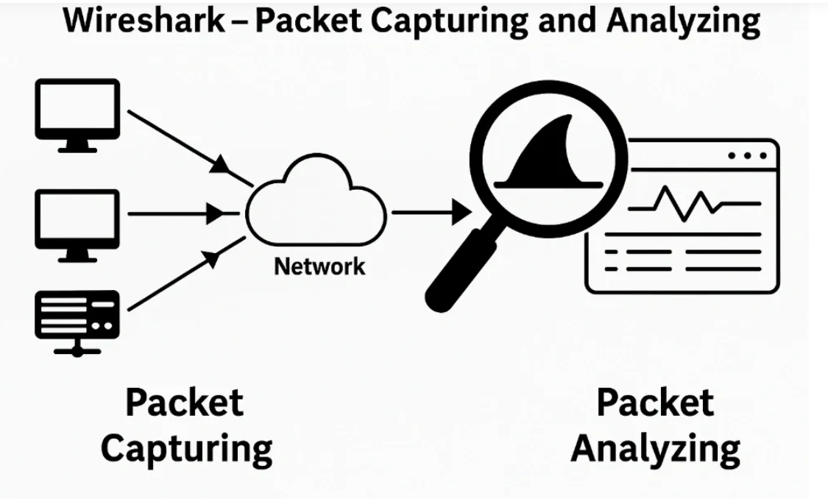

Slide 112
1. Packet Capturing
Wireshark captures network traffic by placing your Network Interface Card (NIC) into promiscuous mode, allowing it to view all packets on the network segment, not just those addressed to your system.
How Capturing Works
Captures traffic in real time and stores it in .pcap or .pcapng files
Uses Npcap (Nmap’s packet capture library) on modern systems
Supports capture filters to limit what is collected (e.g., only HTTP packets or traffic from a specific IP)

Slide 113
Examples of capture filters:
host 192.168.1.10
net 10.0.0.0/24
src port 53
tcp and not port 80

Slide 114
2. Packet Analysis
After capturing, Wireshark offers powerful tools to analyze packets in depth. You can narrow the view using display filters, making it easier to inspect specific conversations or protocols.
Three Analysis Views
Packet List Pane: Summary of all packets
Packet Details Pane: Layer-by-layer protocol breakdown
Packet Bytes Pane: Raw hexadecimal + ASCII view

Slide 115
Examples of display filters:
tcp.port == 80
ip.addr == 192.168.1.5
http.request.uri contains "login"
ip.src == 192.168.0.0/16 and ip.dst == 192.168.0.0/16

Slide 116
Why Packet Sniffing Matters?
Packet sniffing is a crucial part of network reconnaissance, monitoring, and troubleshooting.
Wireshark helps you:
Detect network issues
Identify malicious or suspicious traffic
Debug and test network applications
Learn how protocols and packets really work
It acts like an “X-ray machine” for network communication.

Slide 117
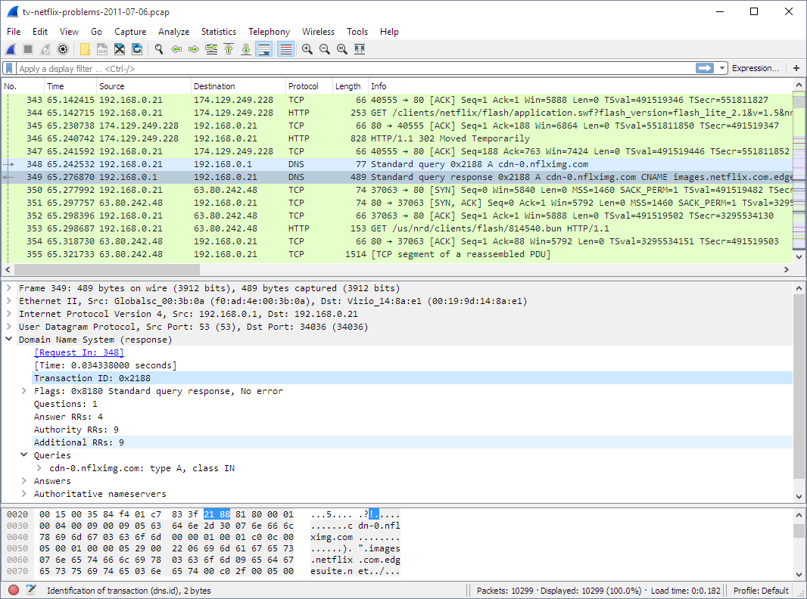

Slide 118
The image in previous slide shows the interfaces on your device.
To start sniffing, select one interface and click on the bluefin icon on the top left.
The data capture screen has three panes.
The top pane shows real-time traffic, the middle one shows information about the chosen packet, and the bottom pane shows the raw packet data.
The top pane shows the source address (IPv4 or IPv6), destination address, source and destination ports, the protocol to which the packet belongs, to and additional information about the packet.

Slide 119
Live capture from many different network media
Wireshark can capture traffic from many different network media types, including Ethernet, Wireless LAN, Bluetooth, USB, and more. The specific media types supported may be limited by several factors, including your hardware and operating system.

Slide 120
Capture Filters
Capture filters in Wireshark allow you to restrict which packets are recorded before the capture begins. They help reduce noise by collecting only the traffic you're interested in.
Common Capture Filters
1. host: Captures traffic to or from a specific device Example: host 192.168.1.10

Slide 121
2. net: Captures traffic within a network or subnet Example: net 192.168.1.0/24 Can be prefixed with src or dst for direction control:
src net 10.0.0.0/8
dst net 172.16.0.0/16
3. port: Captures traffic on a specific port Example: port 80 Can also use direction:
src port 53
dst port 443

Slide 122
Applications of Wireshark
Wireshark can be used for a wide range of practical tasks, such as:
Diagnosing network or Wi-Fi connectivity problems
Monitoring devices for unusual or malicious traffic
Testing and debugging network-enabled applications
Learning and teaching how network protocols operate
Network forensics and security investigations

Slide 123
Model for Network Security
A Network Security Model explains how secure communication is achieved over an insecure network using security services, mechanisms, and protocols.
Defines the framework for secure data transmission over networks
Combines security mechanisms, algorithms, and protocols
Protects data against unauthorized access and attacks
Ensures confidentiality, integrity, and authentication
Identifies roles of sender, receiver, attacker, and trusted third party

Slide 124
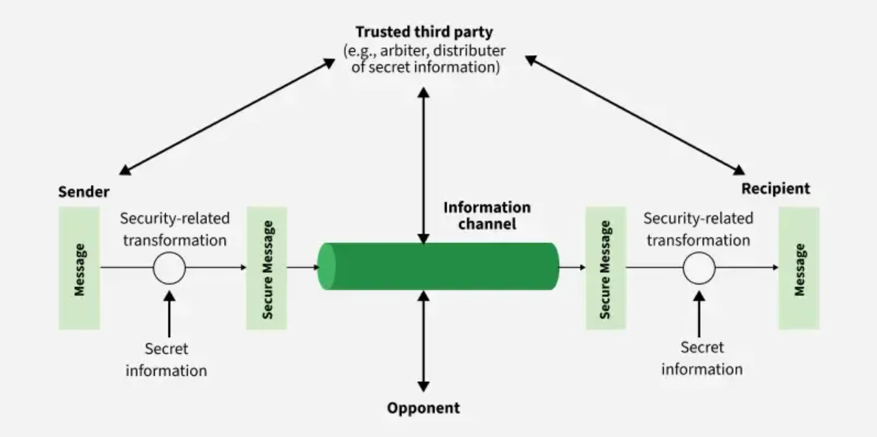

Slide 125
Elements of Network Security Model
1. Sender
The sender is the source of the original message.
It wants to transmit data securely to the intended recipient.
2. Message
This is the original plain data generated by the sender.
Before transmission, it is vulnerable to attacks if sent directly.
3. Security-Related Transformation (Sender Side)
The sender applies a security operation such as encryption or digital signature.
This transformation protects the message from unauthorized access or modification.

Slide 126
4. Secret Information
Secret information refers to cryptographic keys or credentials.
These keys are used in the security transformation and must remain confidential.
5. Secure Message
After applying the security transformation, the message becomes a secure message.
This encrypted or signed data is safe to transmit over an insecure network.
6. Information Channel
The information channel represents the communication medium (e.g., Internet).
It is assumed to be insecure and open to interception.

Slide 127
7. Opponent (Attacker)
The opponent is an unauthorized entity attempting to intercept, read, modify, or disrupt the message.
The security model is designed to protect against such attackers.
8. Trusted Third Party (TTP)
A trusted third party (e.g., Certificate Authority) assists in key distribution, authentication, or verification.
It ensures trust between sender and receiver.

Slide 128
9. Security-Related Transformation (Receiver Side)
The receiver applies a reverse security process such as decryption or signature verification.
This process uses the corresponding secret information.
10. Recipient
The recipient is the intended destination of the message.
After successful transformation, the original message is recovered securely.
11. Final Message at Receiver
The receiver obtains the original message in its usable form.
Confidentiality, integrity, and authenticity are preserved.

Slide 129
Real-World Applications of Network Security Model
The Network Security Model is widely used in real-world systems to ensure safe and reliable communication over insecure networks. Its applications include

Slide 130
1. Secure Web Communication (HTTPS)
Used in online banking, e-commerce, and social media.
Encryption and authentication protect data exchanged between users and websites.
2. Online Banking and Financial Transactions
Ensures confidentiality and integrity of account details and transactions.
Uses encryption, authentication, and trusted third parties like banks and payment gateways.

Slide 131
3. Email Security
Protects emails from interception and tampering.
Uses encryption and digital signatures to ensure privacy and sender authenticity.
4. E-Commerce Platforms
Secures customer data such as credit card details and personal information.
Prevents fraud, data theft, and unauthorized access.

Slide 132
Real-Time Communication Security
Real-Time Communication (RTC) refers to communication where data is transmitted and received instantly with very low delay (latency). Examples include:
Voice calls (VoIP)
Video conferencing (Zoom, Google Meet)
Live chat and messaging
Online gaming
Telemedicine systems
Real-Time Communication Security ensures that such live communications are confidential, authentic, and tamper-proof while maintaining low delay and high performance.

Slide 133
Common Threats in Real-Time Communication
a) Eavesdropping
Attackers listen to voice or video streams
Common in unsecured networks
b) Man-in-the-Middle (MITM) Attack
Attacker intercepts real-time data and may alter it
c) Session Hijacking
Attacker takes control of an active communication session
d) Replay Attacks
Previously captured packets are resent to disrupt communication
e) Denial of Service (DoS)
Flooding servers to disrupt live calls or streams

Slide 134
Real-Time Communications Examples
Voice and video calls: Applications such as Skype, Zoom, and FaceTime enable users to make voice and video calls over the internet in real time.
Video conferencing: Applications such as Zoom, Skype, and Google Meet enable users to participate in video conferences with multiple participants.
Instant messaging: Applications such as Slack, Microsoft Teams, and WhatsApp enable users to send and receive messages in real time.

Slide 135
Live streaming ? Applications such as YouTube Live and Facebook Live enable users to stream video in real time over the internet.
Overall, RTC applications enable users to communicate and interact with each other in real time, regardless of their location.
These applications have become an important part of the modern communication landscape and are used in a wide range of contexts, including social and business interactions.

Slide 136
Real-Time Communications Vendors And Products
Zooom:
Skype:
Microsoft Teams:

Slide 137
How Real-Time Communication Security Works
Real-time communication security works by securing the entire communication process, from call setup to live data transmission, while keeping delay (latency) very low.
Overall Working Flow (High-Level Idea)
When two users communicate in real time (voice/video/chat), security is applied in three main phases:
Secure signaling (call setup)
Secure key exchange
Secure real-time media transmission

Slide 138
Step 1: Secure Signaling (Call Setup)
Before the actual voice or video starts, devices exchange signaling messages to:
Identify users
Set up session parameters
Decide codecs and protocols
How it is secured:
TLS (Transport Layer Security) is used
Prevents fake call requests and MITM attacks
Example: When you click “Join Meeting” in Zoom, signaling messages are securely exchanged using TLS.

Slide 139
Step 2: Authentication of Users
Each user is verified before joining the session
Prevents unauthorized access
Methods used:
Username & password
One-time password (OTP)
Digital certificates
Meeting IDs and passcodes
Example: Only authenticated users can join a secure video conference.

Slide 140
Step 3: Secure Key Exchange
Once signaling is done, both parties must agree on a shared secret key.
How it works:
Uses asymmetric cryptography
Common method: Diffie-Hellman Key Exchange
Keys are generated dynamically per session
Important point: The encryption key is never sent directly over the network.

Slide 141
Step 4: Encryption of Real-Time Data
Now the actual voice, video, or chat data is transmitted.
How security is applied:
Data is encrypted using symmetric encryption (fast)
Common algorithm: AES
Ensures confidentiality

Slide 142
Step 5: Secure Real-Time Transport (SRTP)
SRTP (Secure Real-time Transport Protocol) is used to:
Encrypt media streams
Ensure data integrity
Protect against replay attacks
SRTP provides:
Encryption → privacy
Message authentication → integrity
Sequence numbers → replay protection

Slide 143
END OF CHAPTER 4

